Slide 1
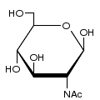
b-D-GlcNAc, pyranose form
C13 isotopic label
on C6
RES
1b:b-dglc-hex-1:5
2s:n-acetyl
LIN
1:1o(2-1)2n
ISO
1:1c(6-c13)

